Slide 1
Processes

Slide 2
*Processes
Communication takes place between processes.
But, what’s a process?
“A program in execution”
Traditional operating systems: concerned with the “local” management and scheduling of processes.
Modern distributed systems: a number of other issues are of equal importance.
There are three main areas of study:
Threads (within clients/servers).
Process and code migration.
Software agents.

Slide 3
Introduction to Threads
Modern OSs provide “virtual processors” within which programs execute.
A programs execution environment is documentated in the process table and assigned a PID.
To achieve acceptable performance in distributed systems, relying on the OS’s idea of a process is often not enough - finer granularity is required.
The solution: Threading.

Slide 4
Problems with Processes
Creating and managing processes is generally regarded as an expensive task (fork system call).
Making sure all the processes peacefully co-exist on the system is not easy (as concurrency transparency comes at a price).
Threads can be thought of as an “execution of a part of a program (in user-space)”.
Rather than make the OS responsible for concurrency transparency, it is left to the individual application to manage the creation and scheduling of each thread.

Slide 5
Two Important Implications
Threaded applications often run faster than non-threaded applications (as context-switches between kernel and user-space are avoided).
Threaded applications are harder to develop (although simple, clean designs can help here).
Additionally, the assumption is that the development environment provides a Threads Library for developers to use (most modern environments do).

Slide 6
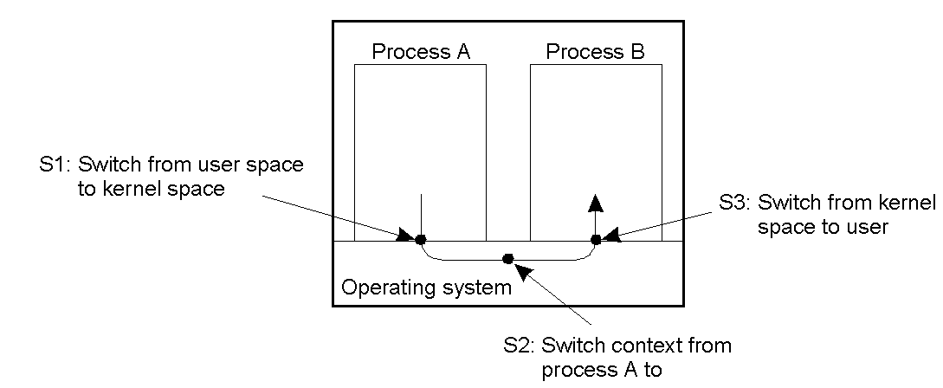
*The Cost of Context-Switches
Context switching as the result of IPC (Inter-process communications).

Slide 7
Threads in Non-Distributed Systems
Advantages:
Blocking can be avoided
Excellent support for multi-processor systems (each running their own thread).
Expensive context-switches can be avoided.
For certain classes of application, the design and implementation is made considerably easier.

Slide 8
Threads in Distributed Systems
Important characteristic: a blocking call in a thread does not result in the entire process being blocked.
The leads to the key characteristic of threads within distributed systems:
“We can now express communications in the form of maintaining multiple logical connections at the same time (as opposed to a single, sequential, blocking process).”

Slide 9
Example: MT Clients and Servers
Mutli-Threaded Client: to achieve acceptable levels of perceived performance, it is often necessary to hide communications latencies.
Consequently, a requirement exists to start communications while doing something else.
Example: modern web browsers.
This leads to the notion of “truly parallel streams of data” arriving at a multi-threaded client application.

Slide 10
Example: MT-Servers
Although threading is useful on clients, it is much more useful in distributed systems servers.
The main idea is to exploit parallelism to attain high performance.
A typical design is to organise the server as a single “dispatcher” with multiple threaded “workers”, as diagrammed overleaf.

Slide 11
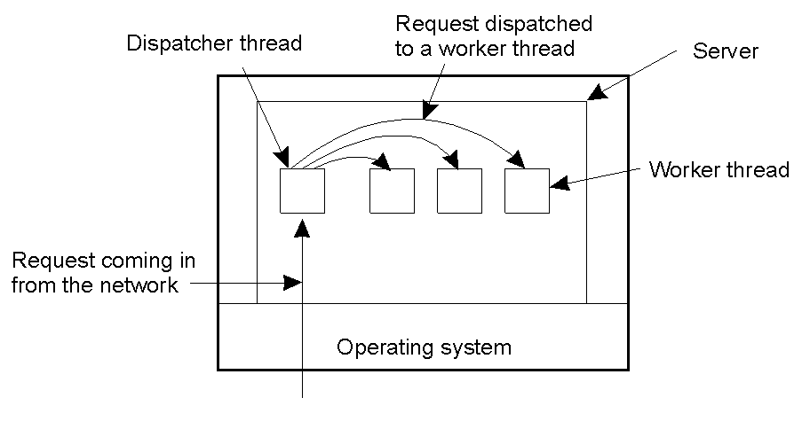
An Multi-Threaded Server
A multithreaded server organized in a dispatcher/worker model.

Slide 12
More on Clients and Servers
What’s a client?
Definition: “A program which interacts with a human user and a remote server.”
Typically, the user interacts with the client via a GUI.
Of course, there’s more to clients than simply providing a UI. Remember the multitiered levels of the Client/Server architecture from earlier …

Slide 13
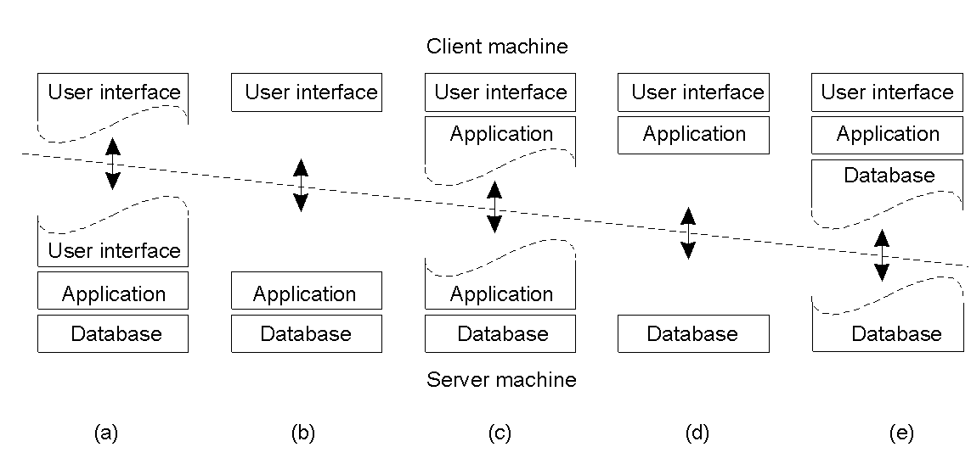
Multitiered Client Architectures

Slide 14
What’s a Server?
Definition: “A process that implements a specific service on behalf of a collection of clients”.
Typically, servers are organised to
do one of two things:
Wait
Service
… wait … service … wait … service … wait …

Slide 15
Servers: Iterative and Concurrent
Iterative: server handles request, then returns results to the client; any new client requests must wait for previous request to complete (also useful to think of this type of server as sequential).
Concurrent: server does not handle the request itself; a separate thread or sub-process handles the request and returns any results to the client; the server is then free to immediately service the next client (i.e., there’s no waiting, as service requests are processed in parallel).

Slide 16
Problem: Identifying “end-points”?
How do clients know which end-point (or port) to contact a server at? How do they “bind” to a server?
Statically assigned end-points (IANA).
Dynamically assigned end-points (DCE).
A popular variation:
the “super-server” (inetd on UNIX).

Slide 17
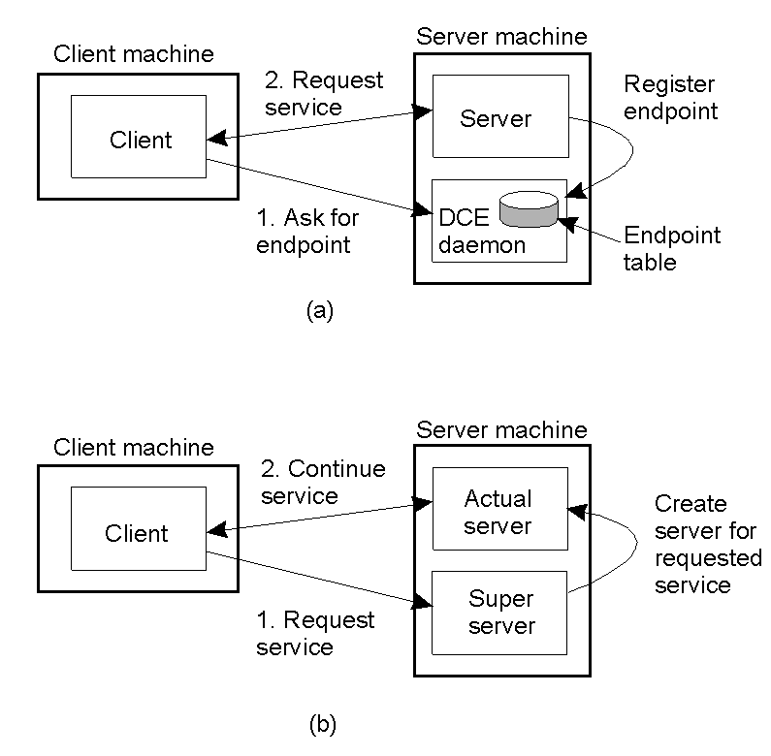
Servers: Binding to End-Points
3.7
Client-to-server binding using a daemon (DCE).
Client-to-server binding using a super-server (inetd on UNIX).

Slide 18
Server “States”
Stateless servers – no information is maintained on the current “connections” to the server. The web is the classic example of a stateless service. As can be imagined, this type of server is easy to implement.
Stateful servers – information is maintained on the current “connections” to the server. Advanced file servers, where copies of a file can be updated “locally” then applied to the main server (as the server knows the state of things). These are more difficult to implement.
But, what happens if something crashes?
(More on this later).

Slide 19
A Special Type: Object Servers
A server tailored to support distributed objects.
Does not provide a specific service.
Provides a facility whereby objects can be remotely invoked by non-local clients.
Consequently, object servers are highly adaptable.
“A place where objects live”.

Slide 20
Code Migration
Under certain circumstances, in addition to the usual passing of data, passing code (even while it is executing) can greatly simplify the design of a distributed system.
However, code migration can be inefficient and very costly.
So, why migrate code?

Slide 21
Reasons for Migrating Code
Why?
Biggest single reason: better performance.
The big idea is to move a compute-intensive task from a heavily loaded machine to a lightly loaded machine “on demand” and “as required”.

Slide 22
Code Migration Examples
Moving (part of) a client to a server – processing data close to where the data resides. It is often too expensive to transport an entire database to a client for processing, so move the client to the data.
Moving (part of) a server to a client – checking data prior to submitting it to a server. The use of local error-checking (with JavaScript) on webforms is a good example of this type of processing. Error-check the data close to the user, not at the server.

Slide 23
“Classic” Code Migration Example
Searching the web by “roaming”.
Rather than search and index the web by requesting the transfer of each and every document to the client for processing, the client relocates to each site and indexes the documents it finds “in situ”. The index is then transported from site to site, in addition to the executing process.

Slide 24
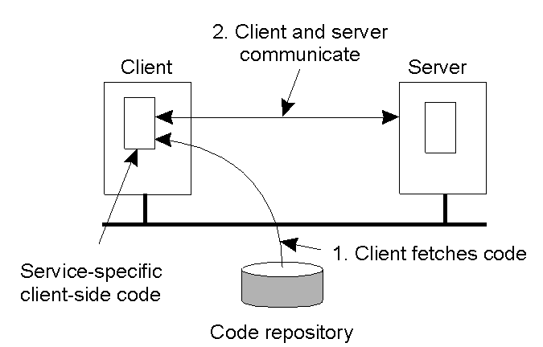
Another Big Advantage: Flexibility
The principle of dynamically configuring a client to communicate to a server. The client first fetches the necessary software, and then invokes the server. This is a very flexible approach.

Slide 25
Major Disadvantage
Security Concerns.
“Blindly trusting that the downloaded code implements only the advertised interface while accessing your unprotected hard-disk and does not send the juiciest parts to heaven-knows-where may not always be such a good idea”.

Slide 26
Code Migration Models
A running process consists of three “seqments”:
Code – instructions.
Resource – external references.
Execution – current state.

Slide 27
Code Migration Characteristics
Weak Mobility: just the code is moved – and it always restarts from its initial state.
Eg. Java Applets.
Comment: simple implementation, but limited applicability.
Strong Mobility: the code and the state is moved – and execution restarts from the next statement.
Eg. D’Agents.
Comment: very powerful, but hard to implement.

Slide 28
More Characteristics
Sender- vs. Receiver-Initiated.
Which side of the communication starts the migration?
The machine currently executing the code (known as sender-initiated)
or
The machine that will ultimately execute the code (known as receiver-initiated).

Slide 29
How Does the Migrated Code Run?
Another issue surrounds where the migrated code executes:
Within an existing process (possibly as a thread)
or
Within it’s own (new) process space.
Finally, strong mobility also supports the notion of “remote cloning”: an exact copy of the original process, but now running on a different machine.

Slide 30
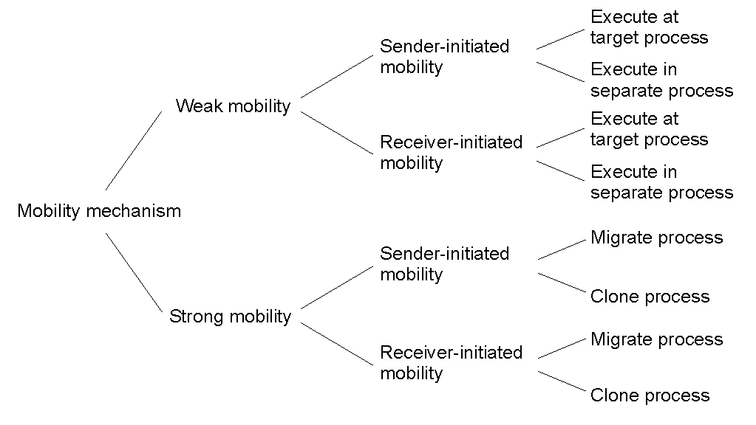
The Models of Code Migration

Slide 31
What About Resources?
This is tricky.
What makes code migration difficult is the requirement to migrate resources.
Resources are the external references that a process is currently using, and includes (but is not limited to):
Variables, open files, network connections, printers, databases, etc., etc.

Slide 32
Types of Process-to-Resource Binding
Strongest: binding-by-identifier (BI) – precisely the referenced resource, and nothing else, has to be migrated.
Binding-by-value (BV) – weaker than BI, but only the value of the resource need be migrated.
Weakest: binding-by-type (BT) – nothing is migrated, but a resource of a specific type needs to be available after migration (eg, a printer).

Slide 33
More Resource Classification
Resources are further distinguished as one of:
Unattached: a resource that can be moved easily from machine to machine.
Fastened: migration is possible, but at a high cost.
Fixed: a resource is bound to a specific machine or environment, and cannot be migrated.
Refer to diagram 3-14 in the textbook for a good summary of resource-to-binding characteristics (to find out what to do with which resource when).

Slide 34
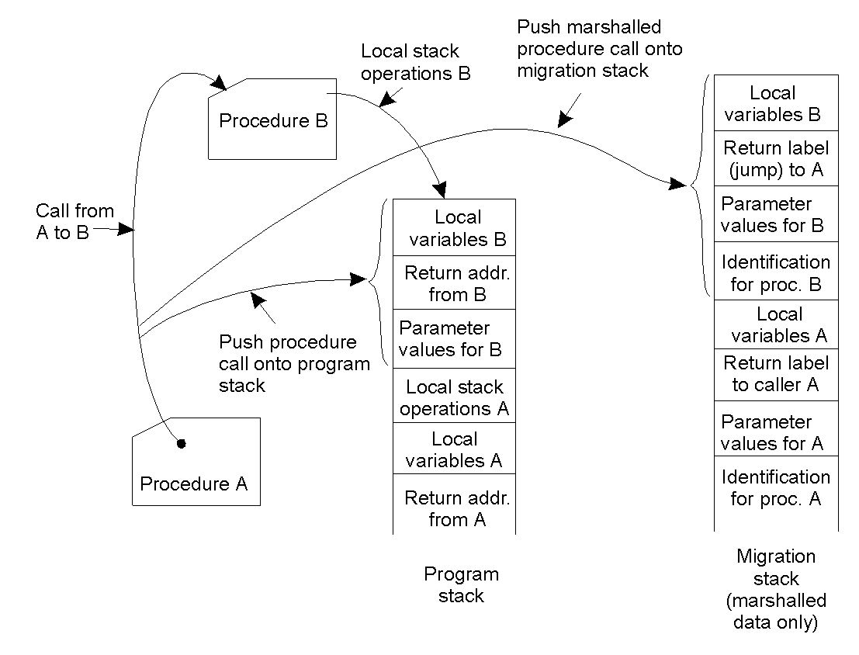
Migration in Heterogeneous DS’s
3-15
Using a migration stack: the principle of maintaining a migration stack to support migration of an execution segment in a heterogeneous environment. Usually requires changes to the programming language and its environment.

Slide 35
Software Agents
What is a software agent?
“An autonomous unit capable of performing a task in collaboration with other, possibly remote, agents”.
The field of Software Agents is still immature, and much disagreement exists as to how to define what we mean by them.
However, a number of types can be identified.

Slide 36
Types of Software Agent
Collaborative Agent – also known as “multi-agent systems”, which can work together to achieve a common goal (eg, planning a meeting).
Mobile Agent – code that can relocate and continue executing on a remote machine.
Interface Agent – software with “learning abilities” (that damned MS paperclip, and the ill-fated “bob”).
Information Agent – agents that are designed to collect and process geographically dispersed data and information.

Slide 37
Software Agents in Distributed Systems
Property | Common to all agents? | Description
Autonomous | Yes | Can act on its own.
Reactive | Yes | Responds timely to changes in its environment.
Proactive | Yes | Initiates actions that affects its environment.
Communicative | Yes | Can exchange information with users and other agents.
Continuous | No | Has a relatively long lifespan.
Mobile | No | Can migrate from one site to another.
Adaptive | No | Capable of learning.
Some important properties by which different types of agents can be distinguished within the Distributed Systems world.

Slide 38
Agent Technology - Standards
The general model of an agent platform has been standardized by FIPA (The “Foundation for Intelligent Physical Agents”) located at the http://www.fipa.org website.
Specifications include:
Agent Management Component.
Agent Directory Service.
Agent Communication Channel.
Agent Communication Language.

Slide 39
Summary - Processes
Processes play a fundamental role in DS’s.
Threads play a central role in building systems that don’t BLOCK when performing I/O – key requirement.
The “classic” process organization model is client/server, and we looked at the various ways to organize the client and the server components.
“Object Servers” are a special case.
Processes can migrate from system-to-system: for performance and flexibility reasons.
Although a simple, and easy to understand, idea, actually realizing this is not that simple (especially within heterogeneous environments).
Standards are immature in this area, but are gaining support within the community (eg, FIPA).

